Slide 1



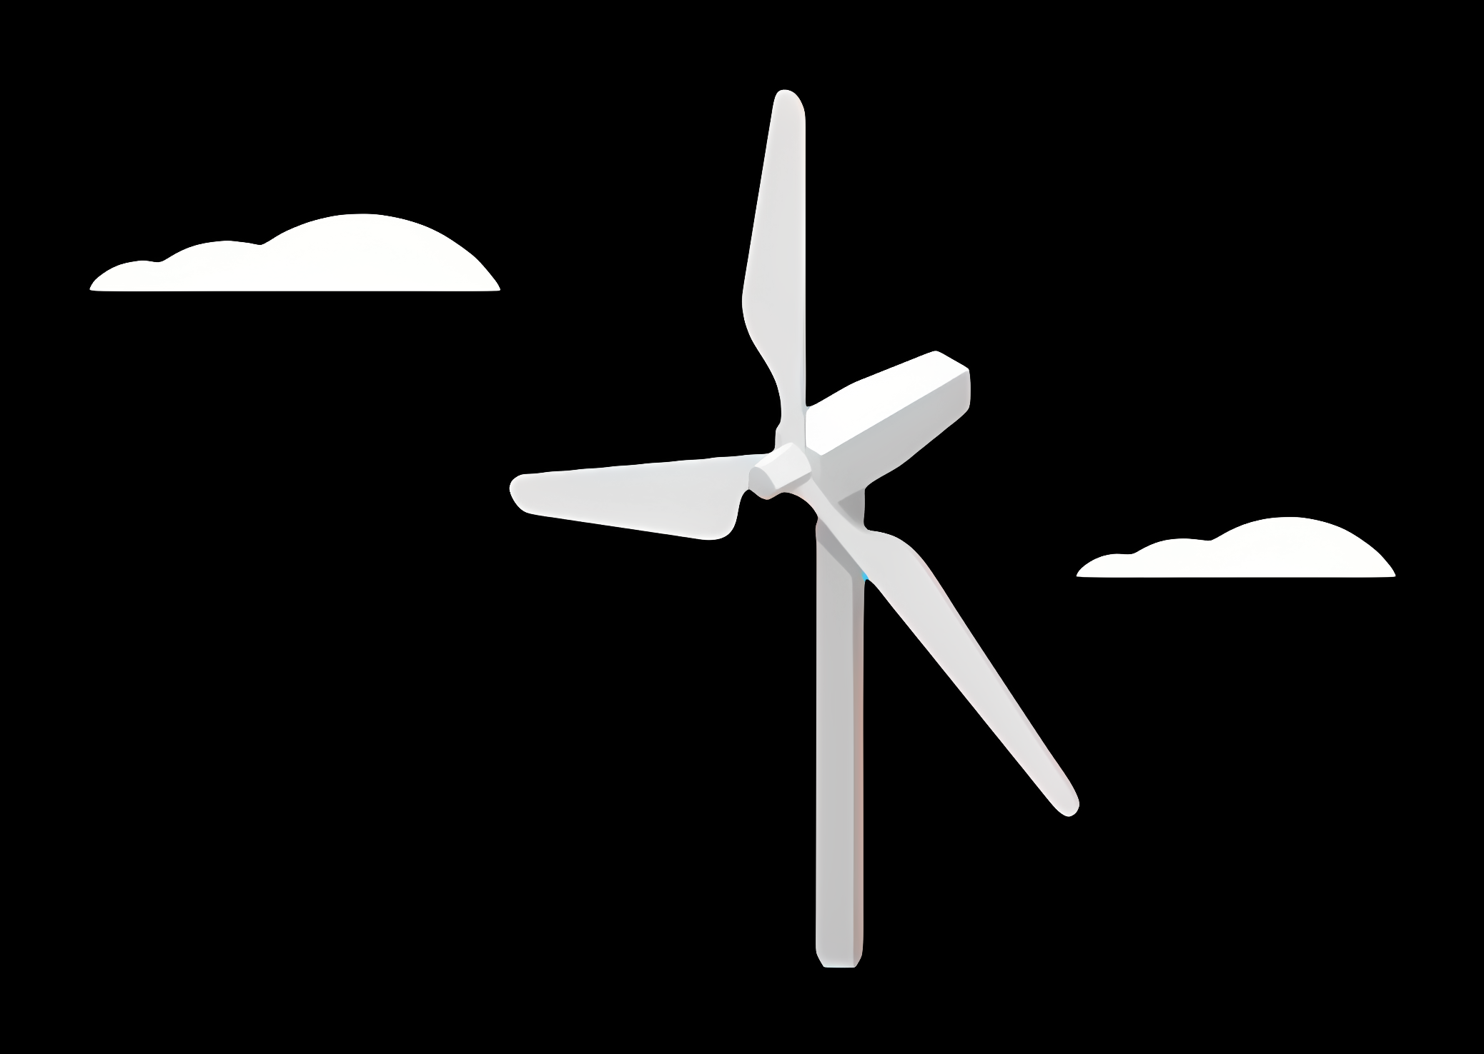
Weekly report: Feedback Controller Team
Week number: 01
Date: 10/09/2025
Supervisor: Prof. Dr.-Ing. David Schlipf
Group members:Mirza Dincer, Saurabh Pankaj Jha

Slide 2
Tasks of the week
Task 1: Compile ROSCO.
Task 2: Do test runs with the reference models.

Slide 3
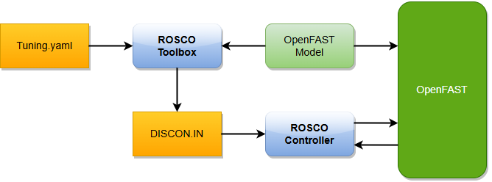
ROSCO – Reference Open-Source Controller
The Reference Open-Source Controller (ROSCO) is an open-source wind turbine controller developed by NREL.
It will be used for the Optimus Syria project.
It is compatible with OpenFAST.
It provides generator torque control and blade pitch control.
Controller features for the Optimus Syria
Generator and blade control with setpoint smoother and filter design
Tower damper
Coupling with Lidar assisted controller
Lidar-Boost: Increase of power when LAC is active
Description of the graph: Standard ROSCO workflow showing controller structure and interaction between OpenFAST and ROSCO. Citation of the sources: [1] Last date of access: 09/09/2025

Slide 4
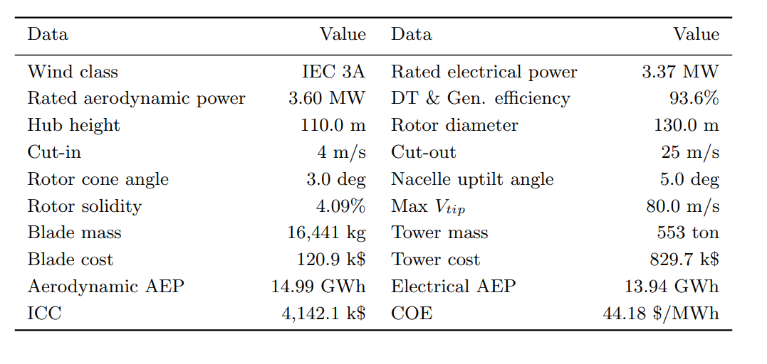
Model Proposal: IEA-3.4-130-RWT
The 3.4 MW Onshore RWT was developed under IEA Wind Task 37 to represent modern onshore wind turbine technology.
It is designed for class IIIA onshore sites.
Optimized for minimum cost of energy.
Description of the graph: Summary of the configuration of the land-based wind turbine.
Citation of the sources: [2] Last date of access: 09/09/2025

Slide 5
Bibliography
[1] “1. Standard ROSCO Workflow — ROSCO 2.9.4 documentation,” Readthedocs.io, 2025. https://rosco.readthedocs.io/en/latest/source/standard_use.html# (accessed Sep. 09, 2025).
[2] P. Bortolotti et al., “IEA Wind TCP Task 37: Systems Engineering in Wind Energy - WP2.1 Reference Wind Turbines,” OSTI OAI (U.S. Department of Energy Office of Scientific and Technical Information), May 2019, doi: https://doi.org/10.2172/1529216.
‌
‌

